Slide 1
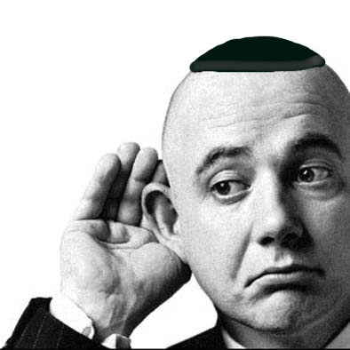
Mentschen Training Active Listening June 7, 2012
Paul Davidson, PhD
V.P. of Training, New England Region

Slide 2
definition
Active Listening – Enhancing communication by utilizing skills which maximize understanding
Requires effort by the listener
Engages the speaker more fully
Elicits more information from the speaker
Creates a positive environment for conversing
Reinforces interest and comprehension

Slide 3
importance
Promotes greater communication within HMV sessions
Crucial to mentoring others
Essential to quality leadership
Enhance interpersonal relations at home
Advantageous in work situations

Slide 4
VALUE
Allows for greater diversity of perspectives
Increases communication satisfaction
Helps overcome a tendency to give advice
Aids in the development of speaking confidence
60% of organizational errors are linked to some failure to actively listen (Wheless, 1998)

Slide 5
Key components
Focused attention
Undivided attention
Look directly at the speaker
Avoid outside distractions
Demonstrate you are listening
Non-verbal communication
Nods, open arms, smiling, etc.
Utilize short comments to keep conversation going

Slide 6
Key components
Offer feedback
Paraphrase to ensure comprehension
Clarify
Summarize
Respond appropriately
Try not to interrupt
Golden rule
Don’t rush to judge
Hear speaker thoroughly before commenting

Slide 7
Levels of active listening
Repeating | Paraphrasing | Reflecting
Restating the message in the speaker’s own words | Using words similar to the speaker’s to convey understanding | Utilizing your own words to deepen understanding of what the speaker has said
“You said….” | “You seem to be saying…” | “Based on what you said, I think…”

Slide 8
tools
Nonverbal communication
Body posture
Tone
Eye contact
Reinforcing gestures
Smiling
Nodding
Facial reactions

Slide 9
tools
Open-ended Questions
Require a response other than “yes” or “no”
Encourages greater exposition of a topic
Suggests there is no right or wrong
Focuses on developing ideas
Values discussion
Examples: How did you feel about... ?
What is the importance of….to you?
Who has influenced you…?

Slide 10
Tools
Empathizing
Trying to put yourself in the others’ position
Set aside your own views
Acknowledge the speaker’s feelings
Your feelings are in synch with the speaker’s
Don’t give advice

Slide 11
Tools
Leading Questions
Keeps conversation going
Can amplify a story
Reflects interest in discussion
Examples: What happened next?
Could you tell us more?
Would like to talk about that?

Slide 12
tools
Restating – “Let me make sure I understand you”
Summarizing – “So what you’re saying is…”
Labeling emotions – “It sounds like you’re feeling…”
Validating experiences – “I appreciate you talking about such a tough situation.”
Probing further – “What do you think would happen if”
Silence
Redirection if things get uncomfortable

Slide 13
tools
Minimal encouragers – “Uh huh”, “OK”, “and”
Feedback – “My take on this is…”
Pauses – Hold back to emphasize a point
Consequences – “Do you remember what happened the last time you did that?”
“I” Statements – keeps the focus on issues and offers emotional input

Slide 14
Tools
“I” Statements
Summarize something specific you heard
Tell how that makes you feel by using “I”
State what you would like to see happen
Decreases defensiveness on the part of the other
Increases productive dialogue

Slide 15
Making an I statement
Say ‘l’ (instead of ‘you’ or ‘they’)
State your feeling
Describe what you observed that created emotion
Explain what it is you are reacting to
Offer a positive alternative to the behavior
#1 I feel ---- #2 ---- when ---- #3 ---- because ----#4---- I’d appreciate it if ---- #5 ----

Slide 16
Communication killers
Why questions – create defensiveness
False reassurance
Giving unsolicited advice
Trying to force someone to talk
Preaching
Interrupting
Patronizing – “I know just how you feel”

Slide 17
Active listening exercise
Break up into pairs, switch for each topic
Take turns listening to each other for 3 minutes
After each issue, provide 30 seconds of feedback to your partner about the experience
Discuss why you got involved in FJMC (use only nonverbals and minimal prompts)
Describe a challenge you faced at work (use open ended questions and paraphrasing)
Talk about a time when you doubted yourself (use reflection and interpretation)

Slide 18
Questions? Comments?
Thank you for
actively listening!

